Slide 1
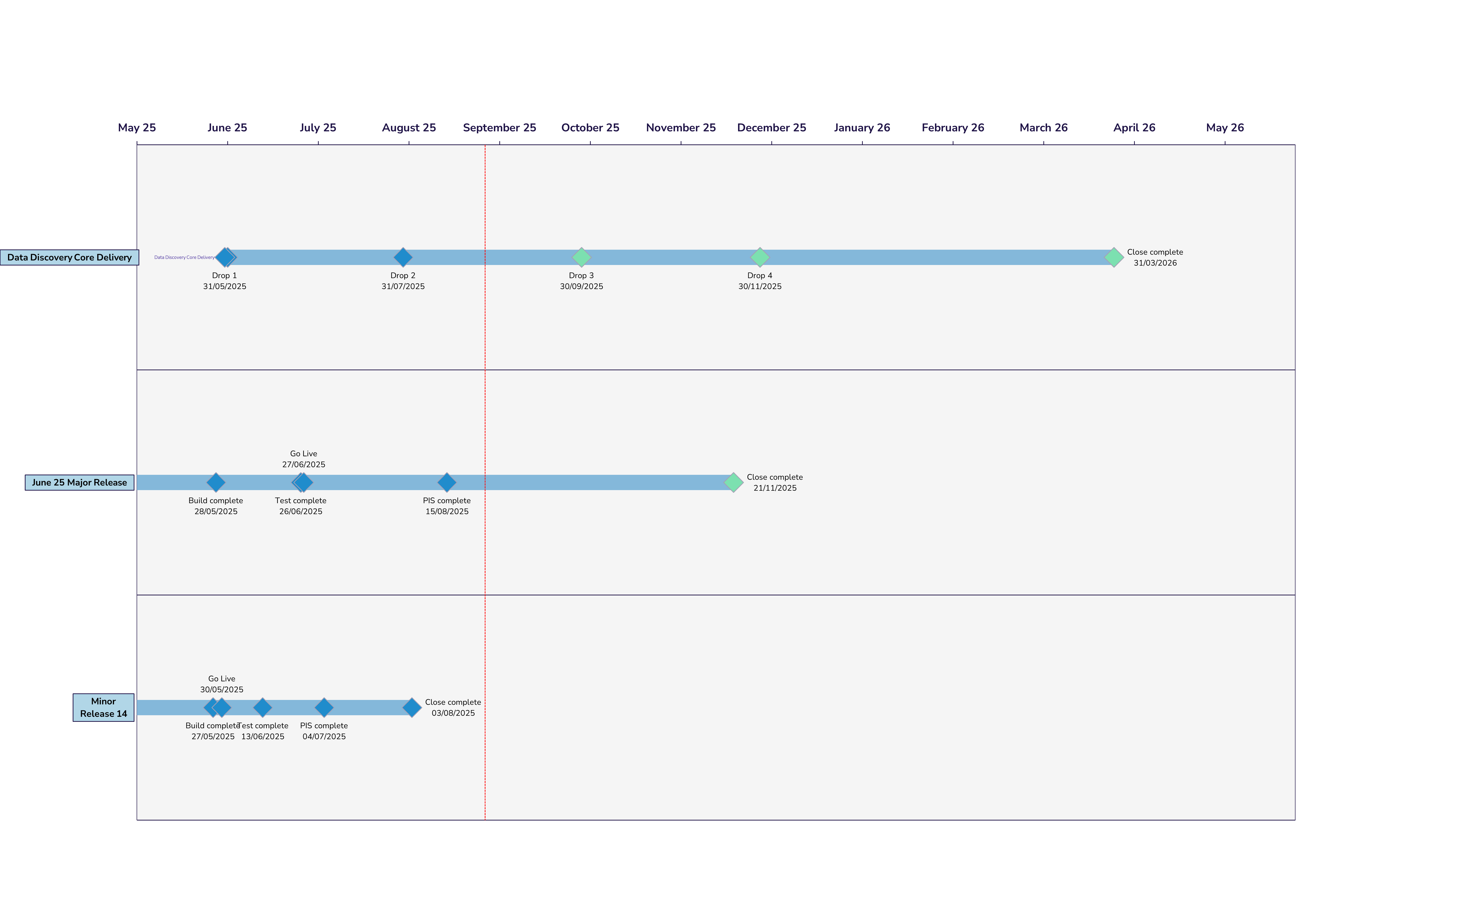
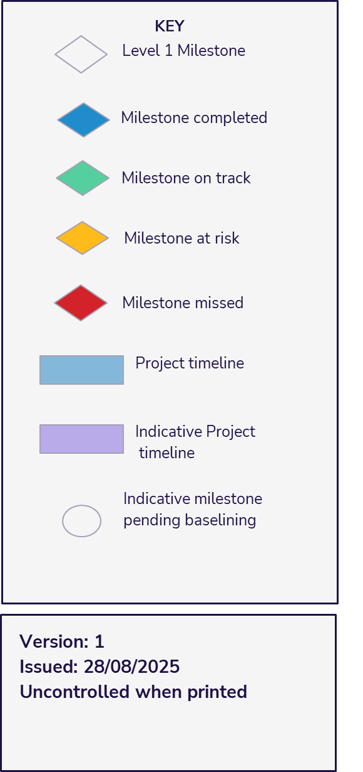
Portfolio Plan On a Page
Notes:
Add bullets

